Slide 1
Synaptic Model

Slide 2

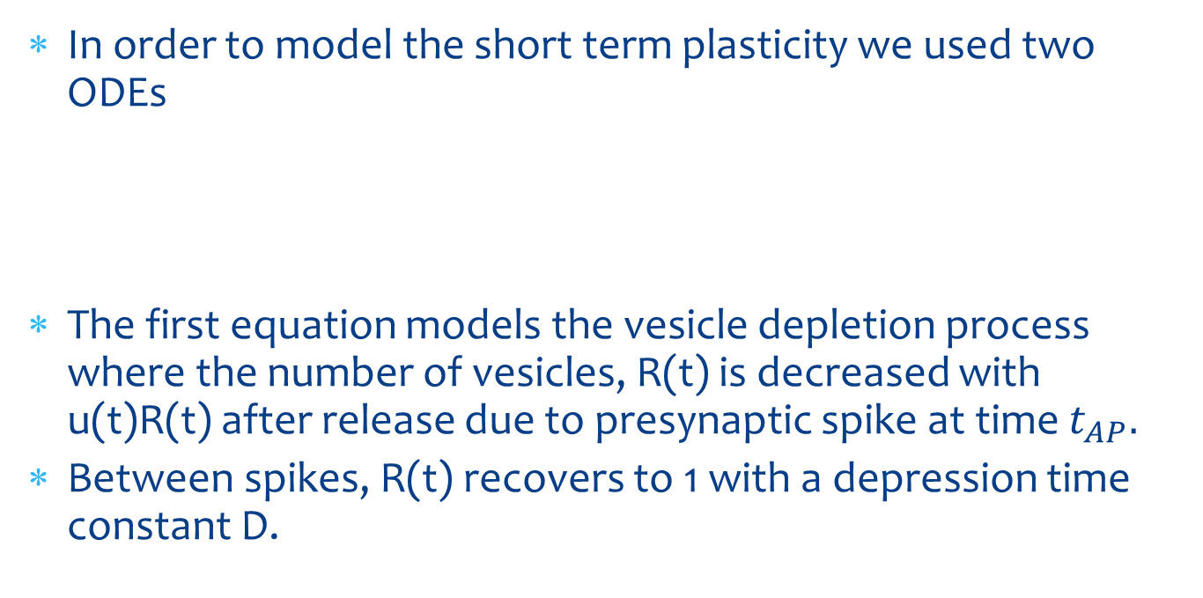
Synaptic model
In order to model the short term plasticity we used two ODEs
The first equation models the vesicle depletion process where the number of vesicles, R(t) is decreased with u(t)R(t) after release due to presynaptic spike at time $t_{AP}.$
Between spikes, R(t) recovers to 1 with a depression time constant D.

Slide 3
Synaptic model
The second equation models the dynamics of the release probability u(t) which increases with f[1-u(t)] after every presynaptic spike, decaying back to baseline release probability U with a facilitation time constant F.

Slide 4

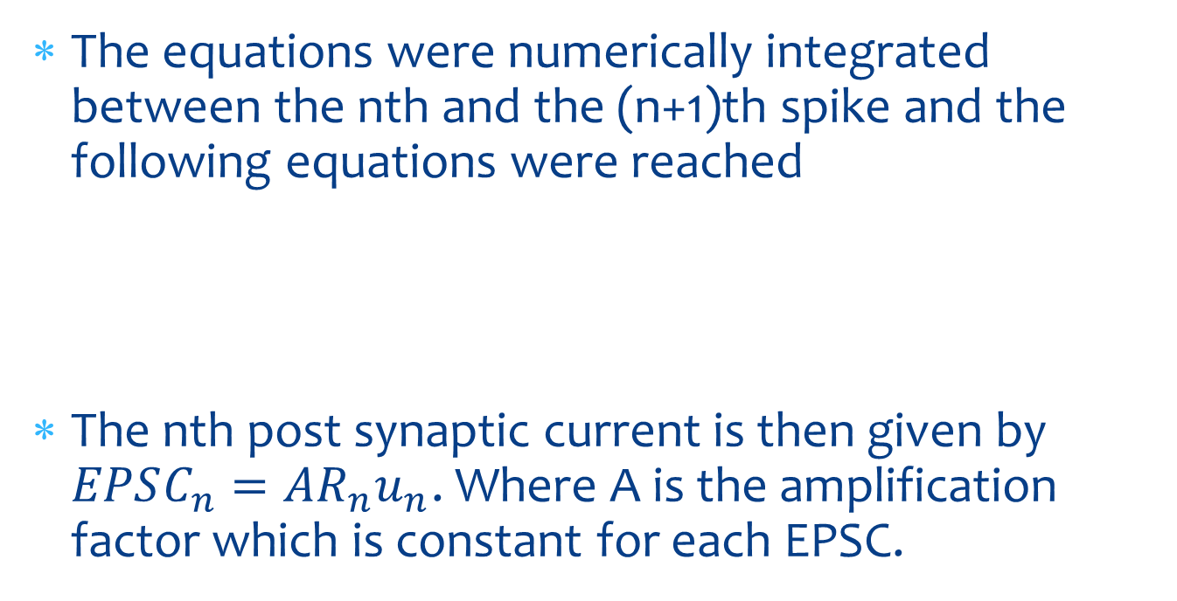
Synaptic model
The equations were numerically integrated between the nth and the (n+1)th spike and the following equations were reached
The nth post synaptic current is then given by $EPSC_{n}=AR_{n}u_{n}$. Where A is the amplification factor which is constant for each EPSC.

Slide 5
Pre-Synaptic Raster plot
For the pre-synaptic spiking rate, we set a Poisson firing rate of 10Hz.
The raster plot displays the action potential of the presynaptic neurons over time.

Slide 6
Connectivity
The connectivity between pre and post synaptic neurons is by a binomial distribution with the parameter p. Each presynaptic neuron has the probability p of being connected to each post synaptic neuron.

Slide 7
Associational Commissural connectivity
In order to simulate the Associational Commissural connections, another set of connections was added to the system between the CA3 neurons to them selves.
The expected result from this simulation was for the network to start firing in sync.
In order to measure this synchronicity, the sync index was defined as is the average number of post synaptic spikes in a predefined time interval.

Slide 8
Simulation 1
For the first simulation we set varying AC connections and test the neural network response.

Slide 9
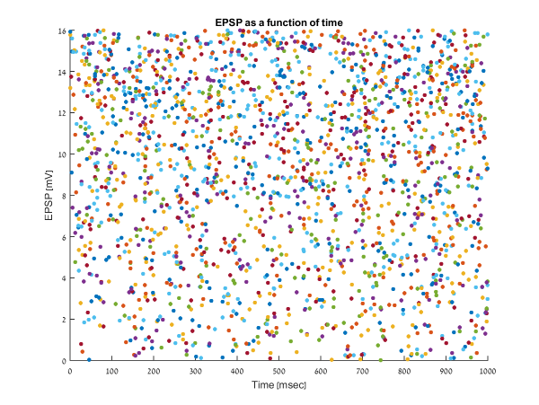
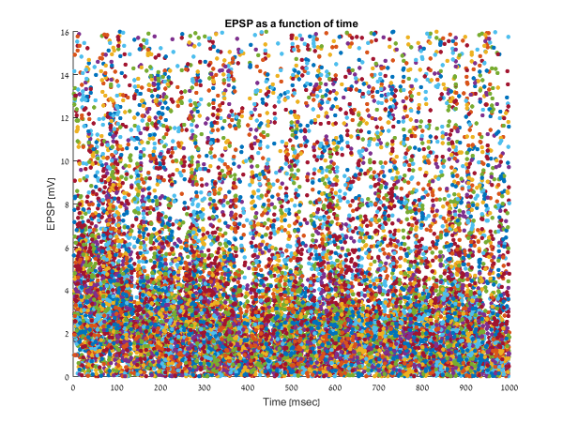
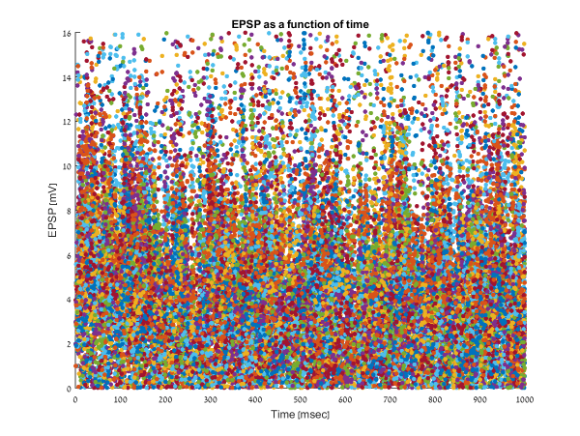
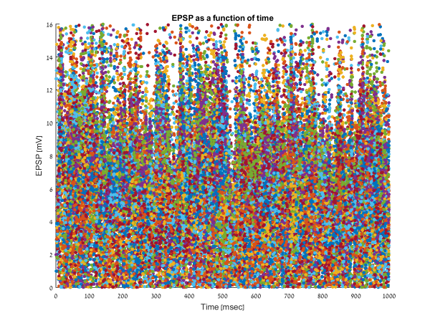
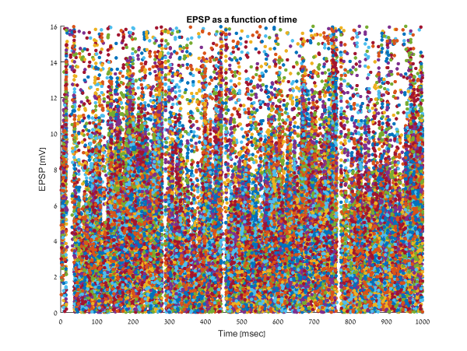
Simulation 1 – EPSPs
pAC = 0
pAC = 0.1
pAC = 0.2
pAC = 0.3
pAC = 0.4

Slide 10
Simulation 1 – Post synaptic raster plot
As can be seen in the next slide, the network becomes more and more active due to the increase in AC connectivity.
At the highest level of connectivity probability, it is easy to notice the “columns” of synchronous spiking.

Slide 11
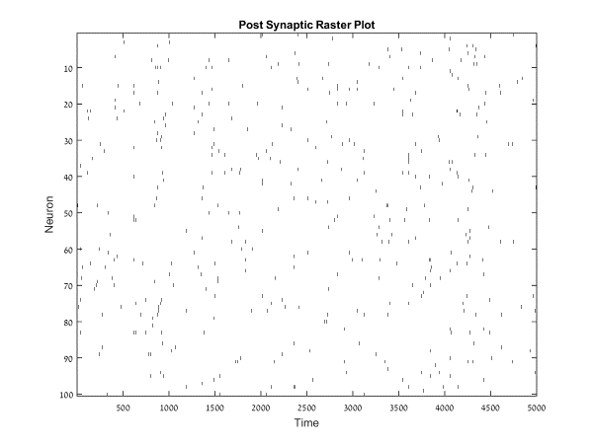
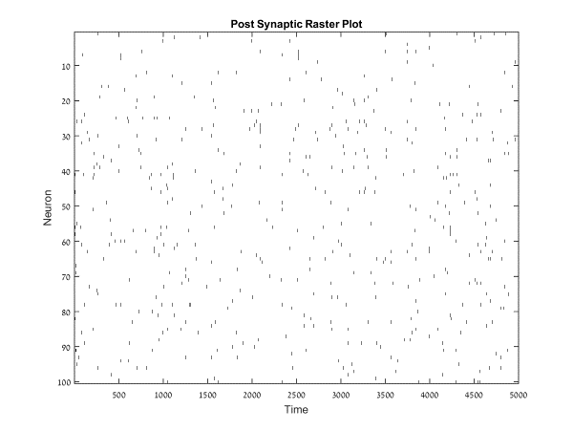
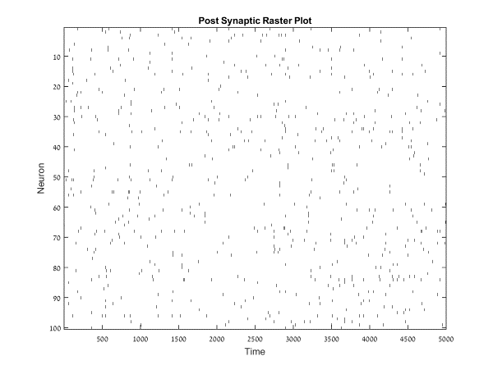
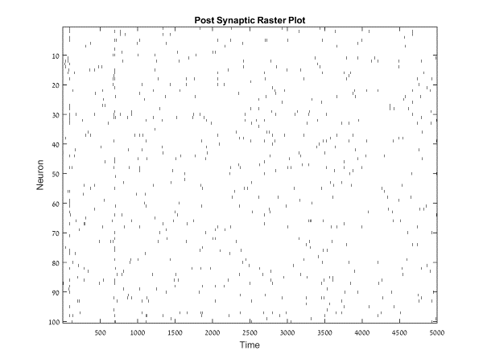
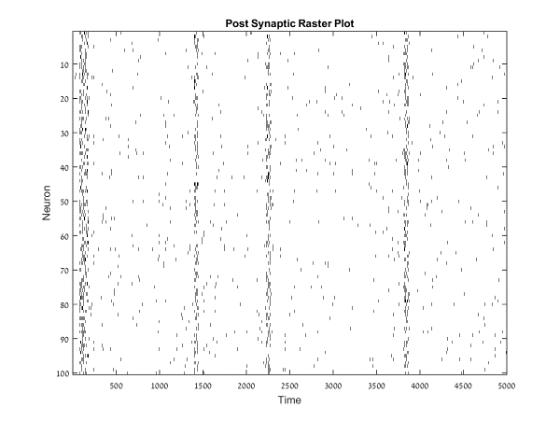
Simulation 1 – Post synaptic raster plot
pAC = 0
pAC = 0.1
pAC = 0.2
pAC = 0.3
pAC = 0.4

Slide 12
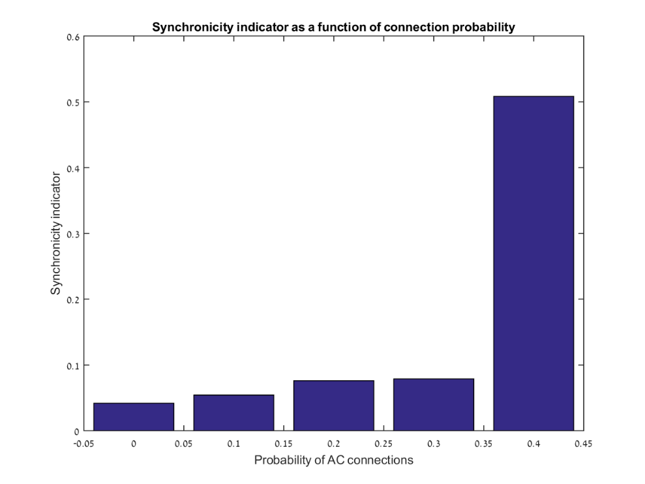
Simulation 1 – Synchronicity indicator
Comparing the different connectivity probabilities using the synchronicity index, it is possible to see that the index grows as the probability of AC connections grows.

Slide 13
Simulation 2
For the second simulation, we used the following table in order to test the response of our model to varying parameters.
The AC connection probability for this simulation was set to 0.1.

Slide 14
Simulation 2 – Table of parameters used to simulate different behaviors
f | U | F(s) | D(s) | Synaptic dynamics regime
0.05 | 0.7 | 0.02 | 1.7 | Strong depression
0.05 | 0.5 | 0.05 | 0.5 | Depression
0.3 | 0.25 | 0.2 | 0.2 | Facilitation-depression
0.15 | 0.15 | 0.5 | 0.05 | Facilitation
0.11 | 0.1 | 1.7 | 0.02 | Strong facilitation

Slide 15
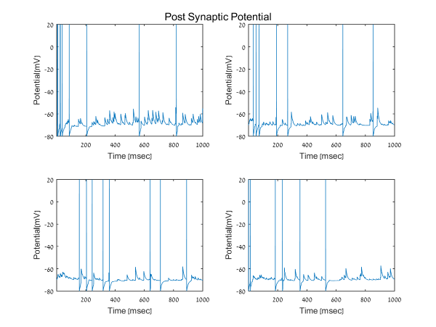
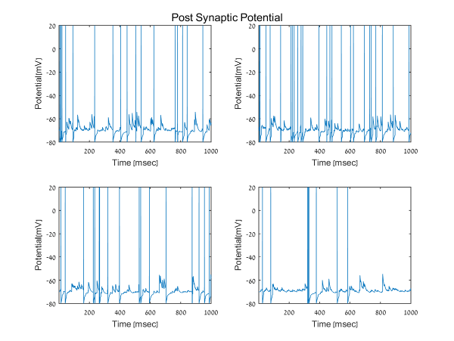
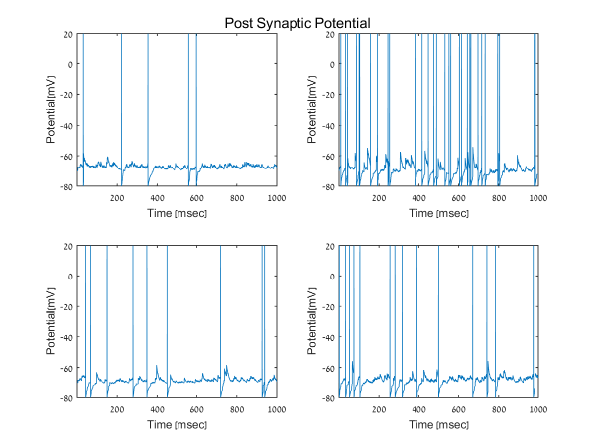
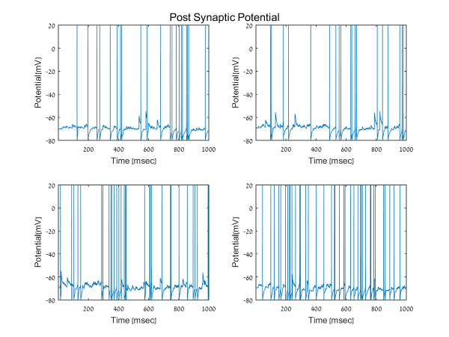
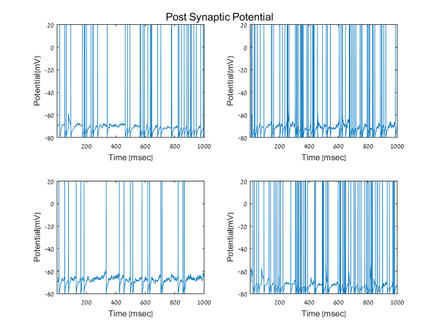
Simulation 2 – Post Synaptic Potential of select neurons
Strong depression
Depression
Facilitation-depression
Facilitation
Strong facilitation

Slide 16
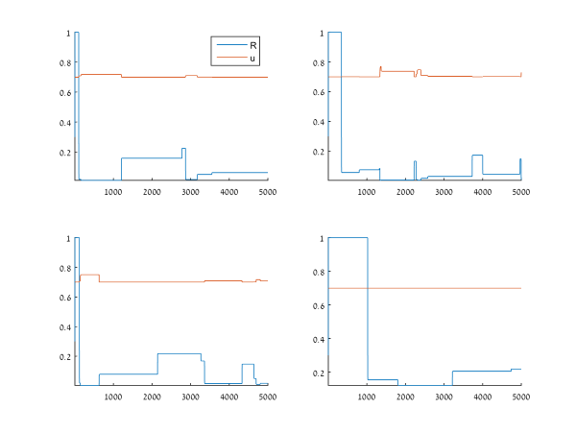
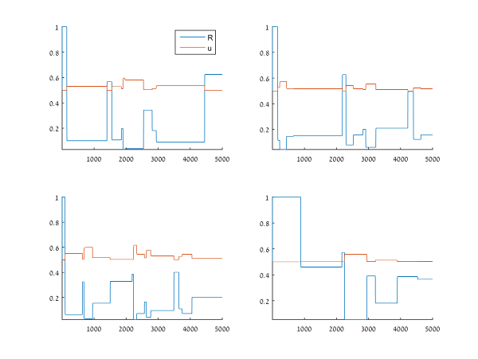
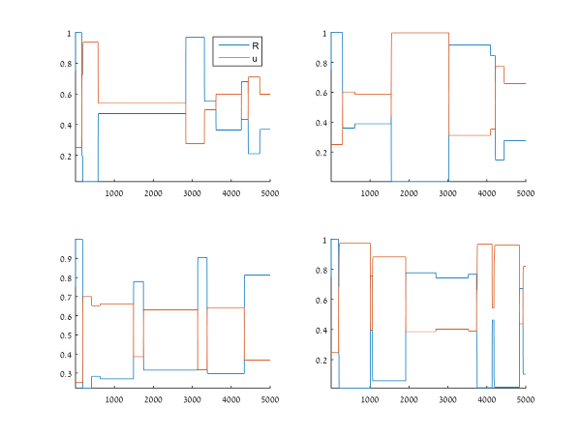
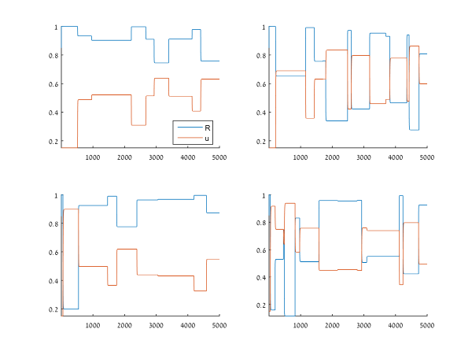
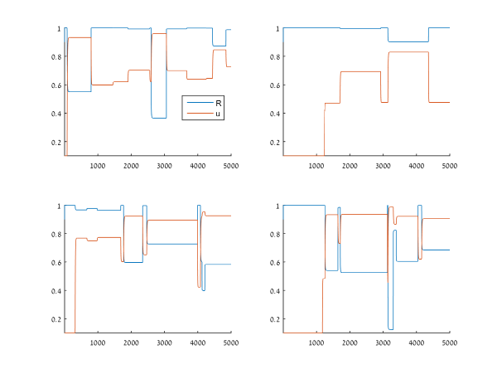
Simulation 2 – u and R
Strong depression
Depression
Facilitation-depression
Facilitation
Strong facilitation

Slide 17
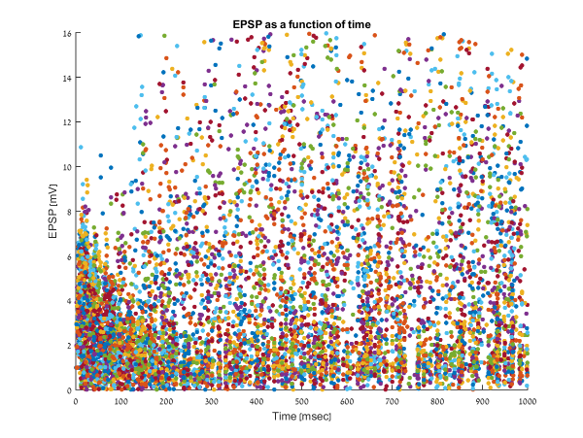
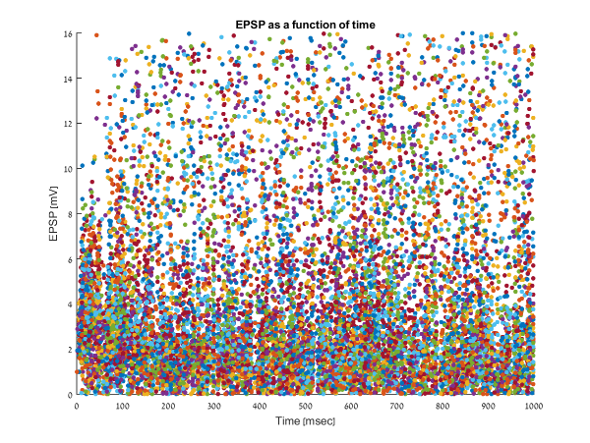
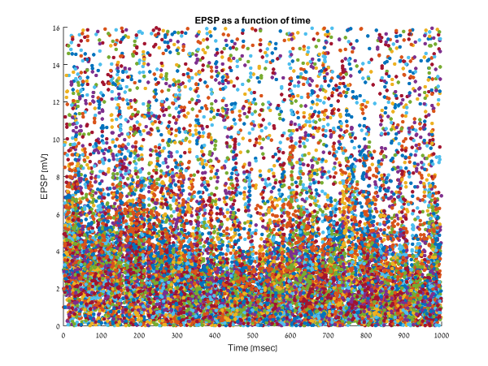
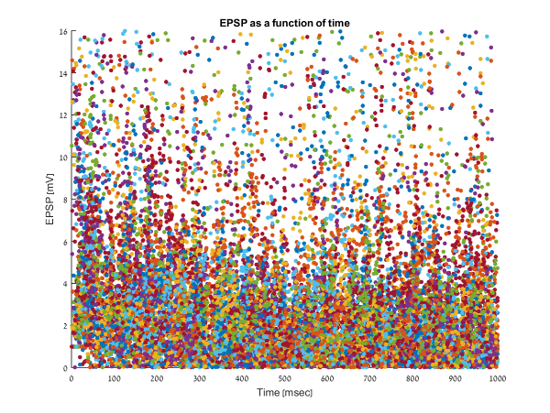
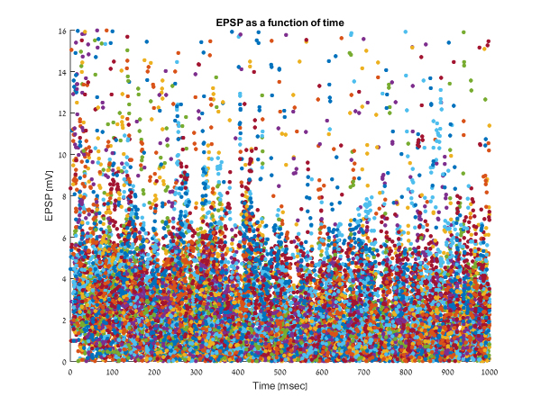
Simulation 2 –PSP over time
Strong depression
Depression
Facilitation-depression
Facilitation
Strong facilitation

Slide 18
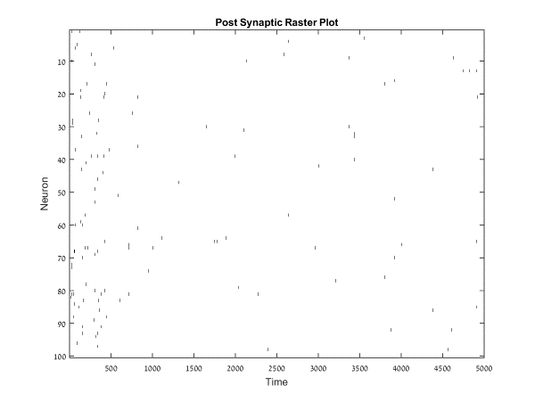

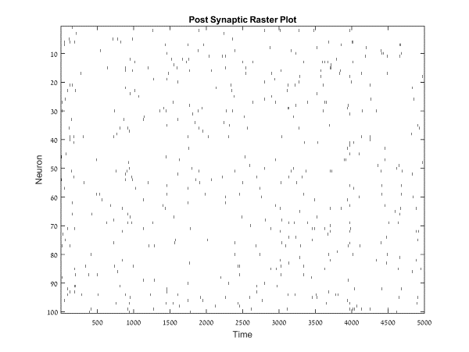
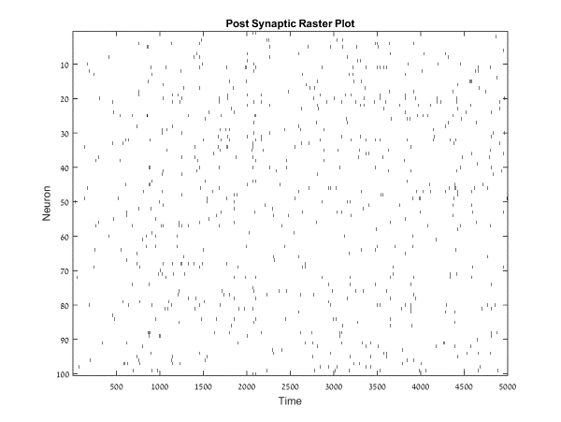
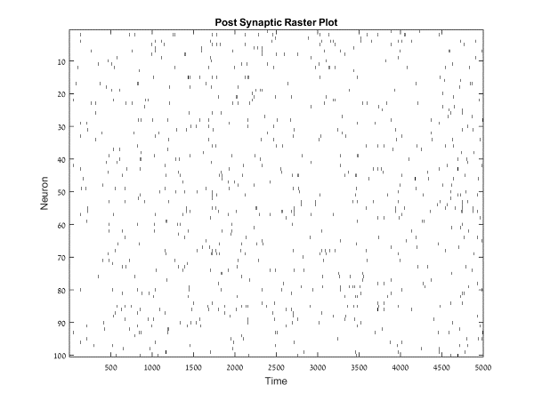
Simulation 2 – Post synaptic raster plot
Strong depression
Depression
Facilitation-depression
Facilitation
Strong facilitation

Slide 19
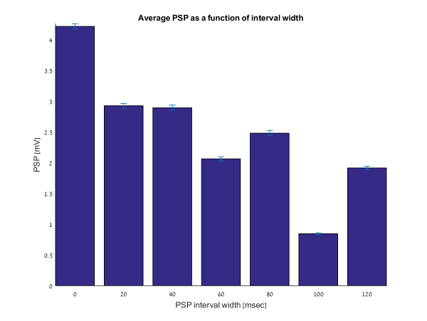
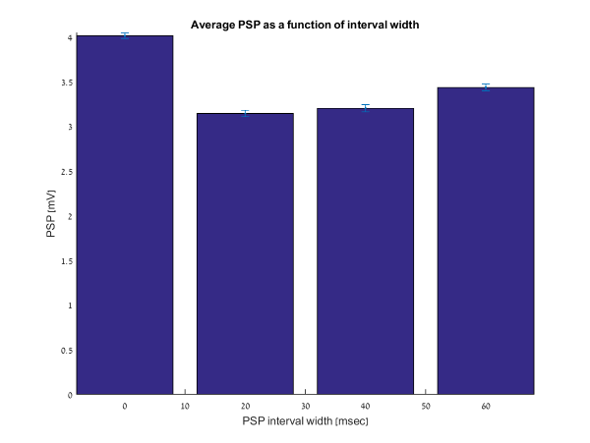
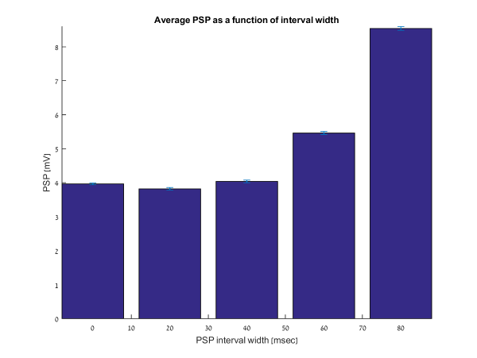
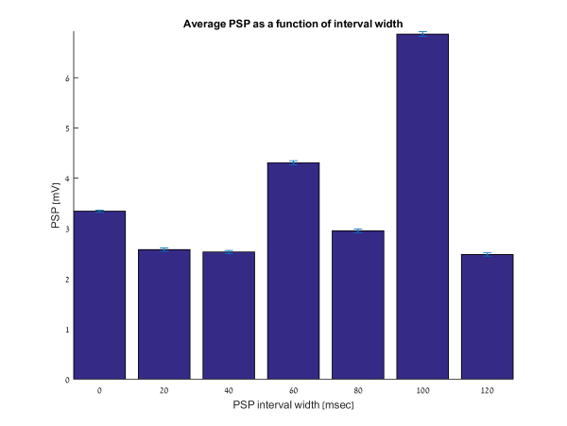
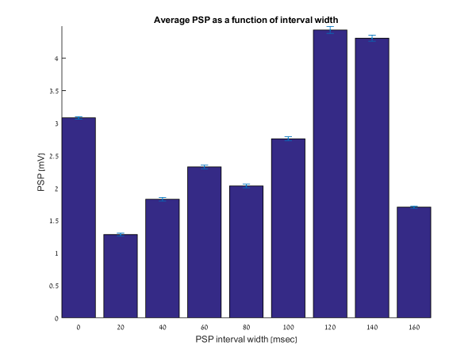
Simulation 2 – PSP as a function of interval
Strong depression
Depression
Facilitation-depression
Facilitation
Strong facilitation

Slide 20
What is next?
The next step is to alter the presynaptic spiking rate so we would get the effect of inter-spike-interval (ISI) and inter-burst-interval (IBI). The spiking rate eventually should be dependent on the time that has passed since the previous spike so for some intervals the probability of another spike would be greater than other intervals.
ISI
IBI
Firing probability
Time since last spike

